Slide 1
Predicting Heart Disease Using Machine Learning Models
Project Name: Predicting Heart Disease Using Machine Learning models
Project Team: IIT1113_Team2
Team Member
Nah Puay Hoon
Lee Chen Lian
Kee Eng Zhen

Slide 2
Final feature sets used for modelling
Dropped features after EDA
Patientid – For patient identification only, not associated to target
Age – High p-value for T-test (0.7918) and low model feature importance (0 & 0.028)
Final feature sets used for modelling (Before transformation)
Categorical_features = ['gender’, 'chestpain’, 'fastingbloodsugar’, 'restingrelectro’, 'exerciseangia', 'slope’, 'noofmajorvessels’]
Numerical features = ['restingBP’, 'serumcholestrol’, 'maxheartrate’, 'oldpeak’]
Feature engineering applied
For Numerical features - StandardScaling
For Categorical_features – OneHotEncoding
Final feature sets used for modelling (After transformation)
Categorical_features = ['gender_0.0', 'gender_1.0', 'chestpain_0.0', 'chestpain_1.0', 'chestpain_2.0', 'chestpain_3.0', 'fastingbloodsugar_0.0', 'fastingbloodsugar_1.0', 'restingrelectro_0.0', 'restingrelectro_1.0', 'restingrelectro_2.0', 'exerciseangia_0.0', 'exerciseangia_1.0', 'slope_1.0', 'slope_2.0', 'slope_3.0', 'noofmajorvessels_0.0', 'noofmajorvessels_1.0', 'noofmajorvessels_2.0', 'noofmajorvessels_3.0']
Numerical features = ['restingBP’, 'serumcholestrol’, 'maxheartrate’, 'oldpeak']

Slide 3
For modelling, The experimentation of different models (Logistic Regression and Random Forest)
Logistic Regression.
reg_param_grid =
{ 'C': [0.01, 0.1, 1, 10, 100], 'penalty': ['l1', 'l2'], 'solver': ['liblinear'], 'class_weight': ['balanced']
'C': [0.01, 0.1, 1, 10, 100]
C is the inverse of the regularization strength.
'penalty': ['l1', 'l2’]
This defines the type of regularization to be applied. The model will be tested with both L1 and L2 regularization.
solver': ['liblinear’]
The solver is the algorithm used to find the optimal coefficients for the model.
'class_weight': ['balanced’]
This hyperparameter is used to handle imbalanced datasets, where one class has significantly more samples
than another.

Slide 4
Random Forest
# Random Forest with hyperparameter tuning
param_grid_rf = { 'n_estimators': [100, 200], 'max_depth': [100, 200, None], 'min_samples_split': [2, 5], 'class_weight': ['balanced’]
n_estimators: [100, 200]
This is the number of decision trees in the forest. A random forest is an ensemble of many individual decision trees, and n_estimators determines how many trees will be built.
max_depth: [100, 200, None]
This parameter controls the maximum depth of each individual decision tree. Depth refers to the number of levels from the
root to the deepest leaf.
min_samples_split: [2, 5]
This determines the minimum number of samples required to split an internal node. A node is a point in the tree where a decision is made to divide the data.
class_weight: ['balanced']
This is used to handle imbalanced datasets, where one class has significantly more samples than another.

Slide 5
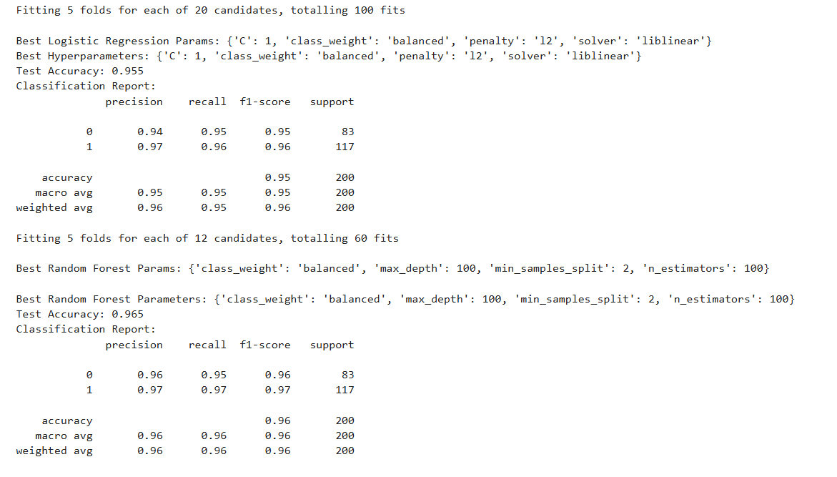
Discussion of the results

Slide 6
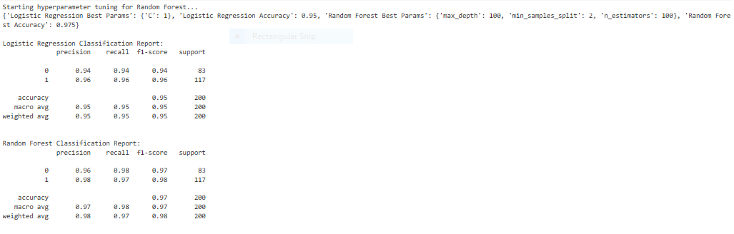
Discussion of the results

Slide 7
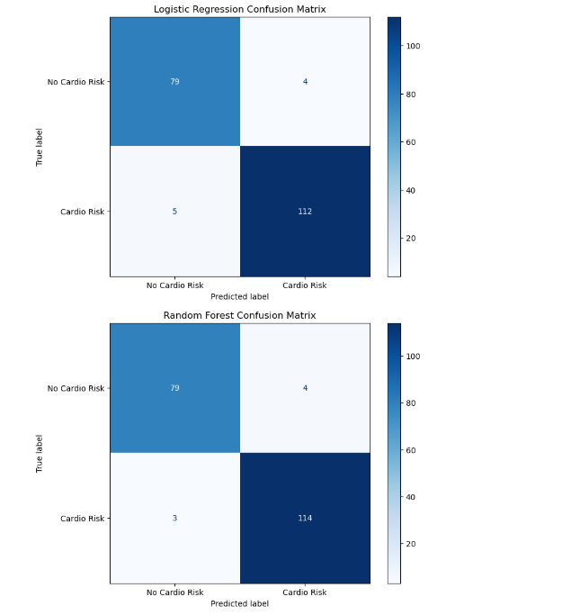
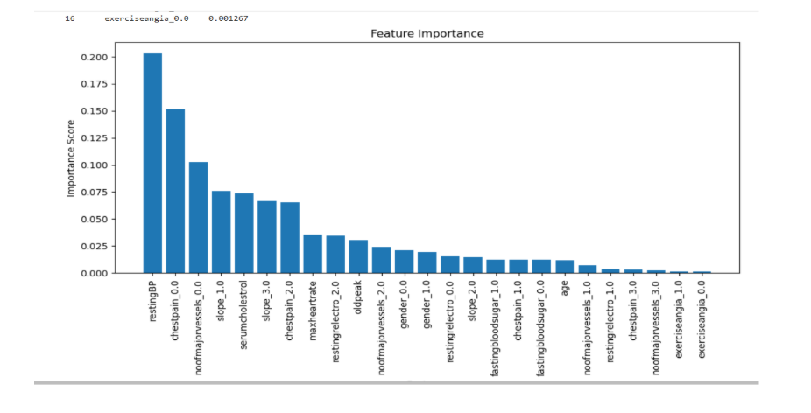
A high feature importance score for a particular feature means that it plays a
significant role in the model's ability to classify instances correctly.
For this model it demonstrate RestingBP, Chestpain, noofmajorvessels and
slope has the highest feature of importance.
Insight
Random Forest is better at identifying cardio risk with Higher True Positive (114 vs 112) and Lower False Negative (3 vs 5). The latter is particularly critical in medical diagnosis as missing cardio risk (false negatives) is worse than falsely labeling a few healthy people.

Slide 8
Error Analysis
Model Performance and Analysis of Mistakes
The models' "mistakes" are the incorrect prediction. In a classification problem, these errors are categorized as False Positives and False Negatives, which are visible in the confusion matrices for each model.
False Negatives: This is the most critical type of error for this problem, as it occurs when the model incorrectly predicts that a patient does not have heart disease when they actually do. The notebook's problem statement correctly identifies that "false negatives can be dangerous" in a medical context.
The Random Forest model, despite being the most accurate, produced 3 false negatives.
The Logistic Regression model produced 5 false negatives.
False Positives: This error occurs when the model incorrectly predicts that a patient has heart disease when they do not. While less dangerous than a false negative, a high number of false positives can lead to unnecessary follow-up tests and patient anxiety.
The Random Forest model produced 4 false positives.
The Logistic Regression model produced 4 false positives.
The Random Forest model performed the best across all metrics, with an accuracy of 96% to 98%. However, no model is perfect. The reason these models make mistakes is due to the inherent complexity of the data, including noisy features or data points that are difficult to classify correctly. For instance, the notebook identified 53 missing valuesin the serumcholestrol column and 180 missing values in the slope column, which were imputed. While imputation is a necessary step, it can introduce approximations that lead to misclassifications.

Slide 9
Hypothesis and Parameters Tuning
of Machine Learning Models

Slide 10
Logistics Regression Model
Model choices:
Logistic Regression with hyperparameter tuning over different regularizations
logreg_param_grid = { 'C': [0.01, 0.1, 1, 10, 100], 'penalty': ['l1', 'l2'],
'solver': ['liblinear'], 'class_weight': ['balanced']}
Hyperparameter tuning:
C (inverse of regularization strength) - [0.01, 0.1, 1, 10, 100],
penalty - (l1, l2).
Validation:
Cross-validation to check generalization. (CV=5)
precision-recall (especially for imbalanced data).
Hypothesis test in ML context:
Does this set of features significantly explain the target?
Yes, given the accuracy of 95% and f1-Score of 96%
Do regularized models improve generalization over baseline?
Yes, the optimal parameter is C = 10 and penalty = l2

Slide 11
Random Forest Model
Model choices:
Base Random Forest at first. (rf = RandomForestClassifier(random_state=42))
Hyperparameter tuning:
n_estimators: number of trees. (100 or 200)
max_depth: maximum depth of each tree. (100, 200 or unlimited)
min_samples_split: control overfitting. (2 or 5)
class_weight: handle imbalance. (‘balanced’)
Validation:
Cross-validation for robust metrics. (CV=5)
Feature importance ranking.
Hypothesis test in ML context:
Does model tuning improve predictive power ?
Yes, optimal metrices were derived, with high accuracy and f1-score.
Does Nonlinear interactions matter?
Yes, in this case, the Nonlinear model provide more accurate prediction.

